Slide 1
SellerID
Name
Email
Phone
Seller
ProdID
Name
Price
Discount
Specification
SellerID
Product
CartId
BuyerId
ProdId
Quantity
Cart
NotificationId
Message
TimeStamp
BuyerId
Notification
SKU ProdID
Price
Size
SKU
BuyerId Name
Email
Phone
Buyer
UserId
Name
Email
Phone
Password
OTP
UserInfo
Order
OrderId
Date
Total
Status
BuyerId

Slide 2
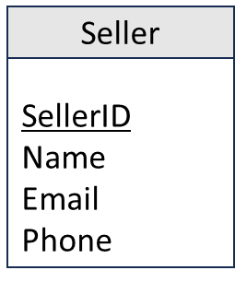
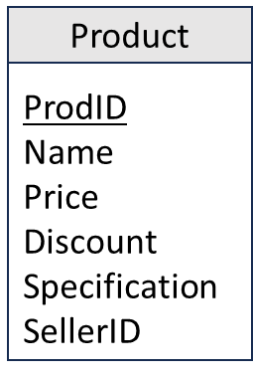
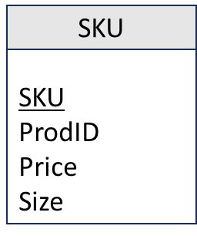
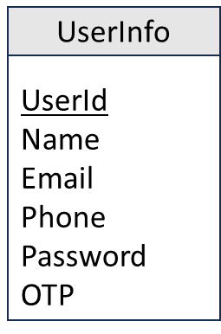
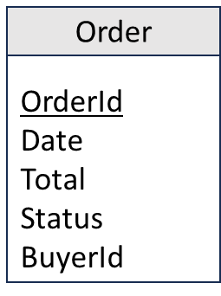
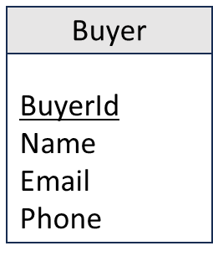
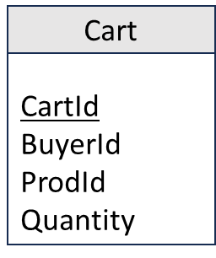
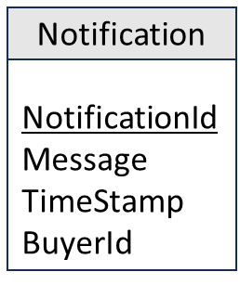
Database Diagram

Slide 3
Entity Relationship Diagram
CartID
BuyerID
ProdID
OrderID
NotificationID
Quantity
Date
BuyerID
Notification
Cart
Order
Total
Message
Status
TimeStamp
Goes in
BuyerID
has a
gives
UserID
OTP
gets a
Name
UserInfo
Phone
Email
Buyer
BuyerID
Phone
Password
Name
has a
Email
has a
Belongs to
SKU
ProdID
Name
SellerID
Supplies
Price
Seller
Size
Email
SKU
Phone
Product
ProdID
Name
SellerID
Price
Specification
Discount

